Slide 1
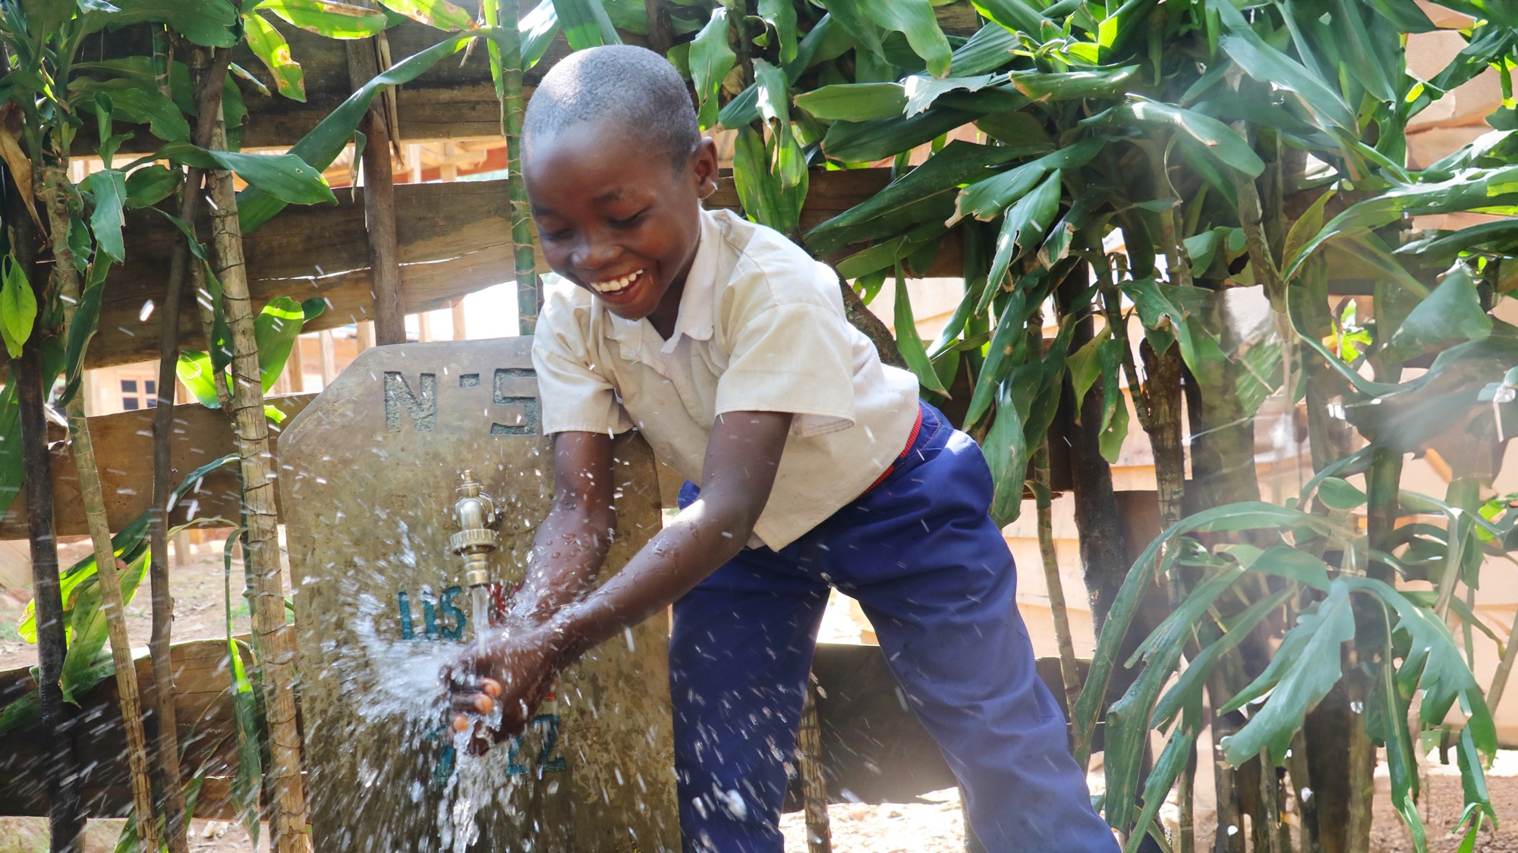

LET’S CELEBRATE!
WE RAISED
$00,000
Every $50 raised means
1 more person received
access to clean water.
worldvision.ca/global6k

