Slide 1
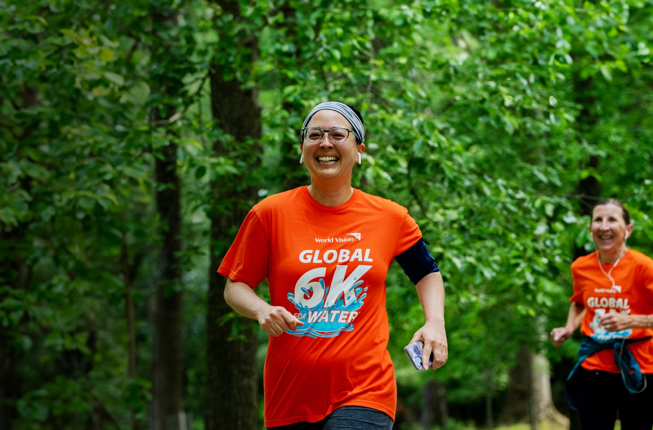


EVERY STEP YOU TAKE IS ONE THEY WON’T HAVE TO.™
Why 6K? It’s the average distance people in the developing world walk for water every day.
When you cross the finish line, you’ll help change the lives of women and children by helping to free them from a life spent collecting dirty water.
DATE & TIME
TEAM NAME
Insert date here
Insert name here
Register today at
worldvision.ca/global6k
LOCATION
Insert location here

Slide 2
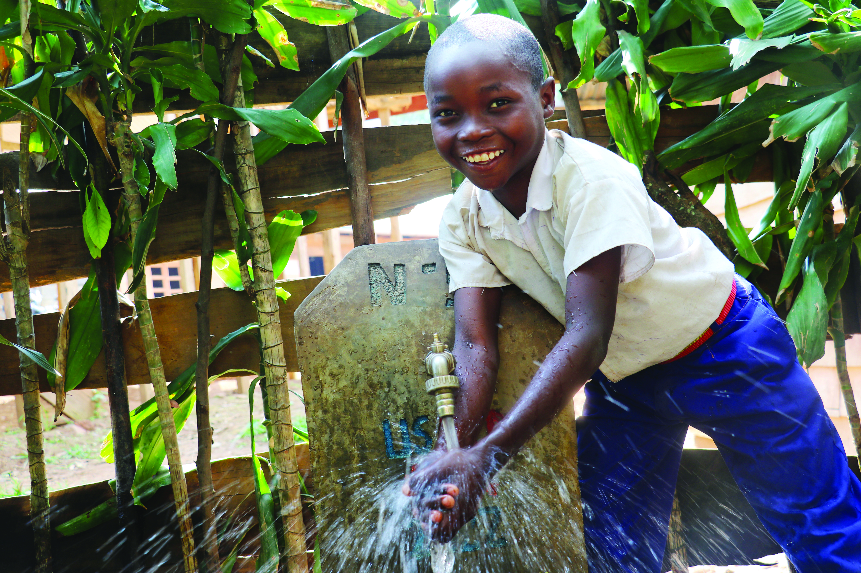
EVERY STEP YOU TAKE IS ONE THEY WON’T HAVE TO.™
Why 6K? It’s the average distance people in the developing world walk for water every day.
When you cross the finish line, you’ll help change the lives of women and children by helping to free them from a life spent collecting dirty water.
DATE & TIME
TEAM NAME
Insert date here
Insert name here
Register today at
worldvision.ca/global6k
LOCATION
Insert location here

Slide 3
EVERY STEP YOU TAKE IS ONE THEY WON’T HAVE TO.™
Why 6K?
It’s the average distance people in the developing world walk for water every day.
DATE & TIME
TEAM NAME
Insert date here
Insert name here
Register today at
worldvision.ca/global6k
LOCATION
Insert location here

Slide 4
EVERY STEP YOU TAKE IS ONE THEY WON’T HAVE TO.™
Why 6K?
It’s the average distance people in the developing world walk for water every day.
DATE
Insert your date here
Register today at
worldvision.ca/global6k
LOCATION
Insert your location here

